Slide 1
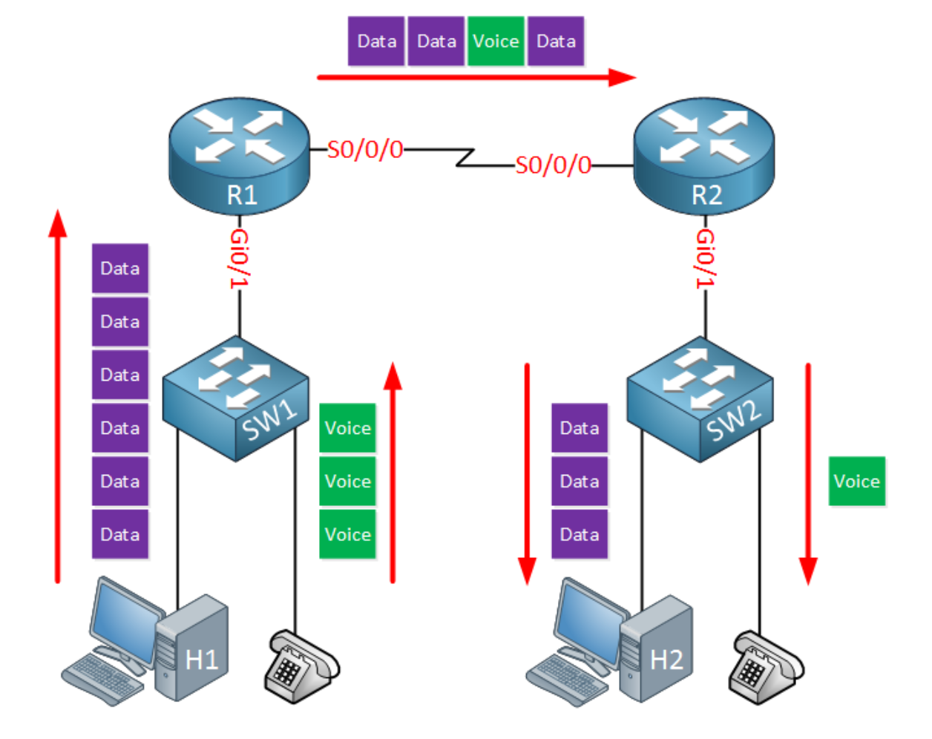
Quality of service. Port mirroring
Lecture 6
SoftUni Team
Technical Trainers
Software University
http://softuni.bg

Slide 2
Table of Contents
Quality of service
Port mirroring
Demonstration

Slide 3
Quality of service (QoS)

Slide 4
What is QoS?
Network devices do NOT care about the type of traffic they need to forward:
Switches use destination MAC
Routers use routing tables
The logic in forwarding is simply FIFO (First In First Out)
QoS is a way to prioritize

Slide 5
Characteristics of network traffic
Bandwidth - the speed of the link
Delay - the time it takes for a packet to get from the source to the destination (can be one-way or round-trip delay)
Jitter - the variation of the one-way delay for each packet
Loss - the amount of the lost data

Slide 6
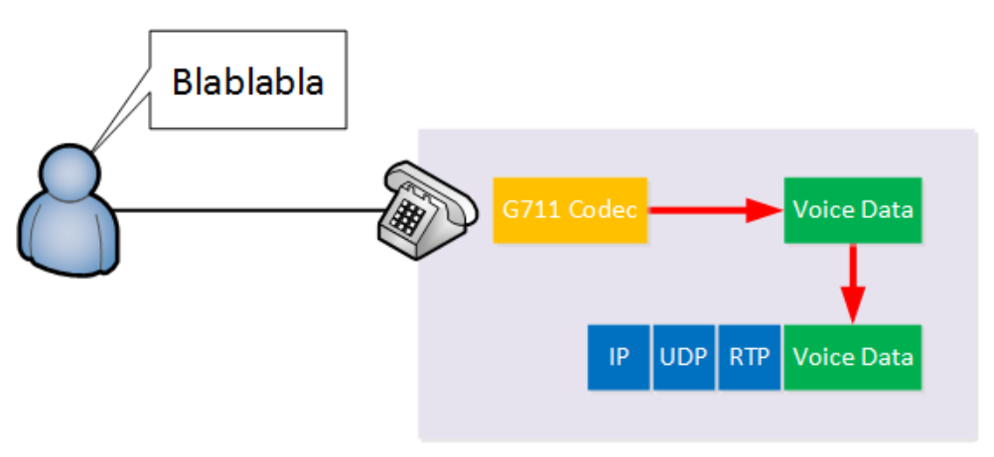
Traffic and application types
Non-interactive application (a.k.a. batch application), for example - downloading a file
bandwidth, delay, jitter, loss
Interactive application, for example Telnet or SSH
bandwidth, delay, jitter, loss
Voice and video application
bandwidth, delay, jitter, loss

Slide 7
QoS tools
Classification and marking
Queuing
Policing and shaping
Congestion avoidance

Slide 8
Classification and marking
For each packet to have different treatment, we have to first identify and mark them
There are different methods to classify a packet:
Header inspection - looks for MAC, IP, port numbers
Payload inspection - looks inside the packet, making deep packet inspection. On Cisco routers, this is done with NBAR (Network-Based Application Recognition)

Slide 9
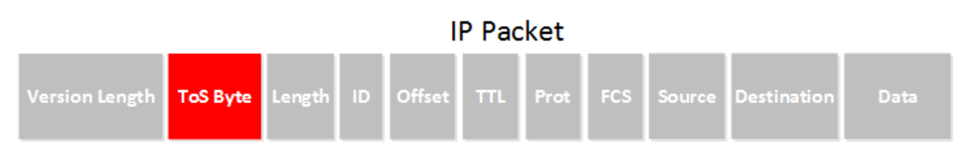
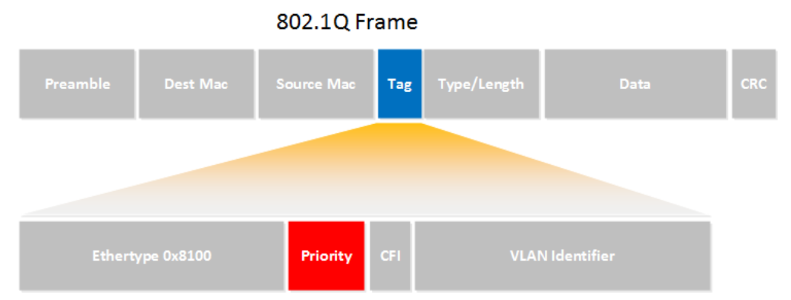
Classification and marking (2)
Once classified, we need to mark the packet or frame
For L3 packets, we modify the ToS field:
For L2 frames, we modify the Priority field (for trunks only):

Slide 10
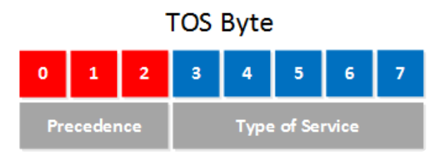
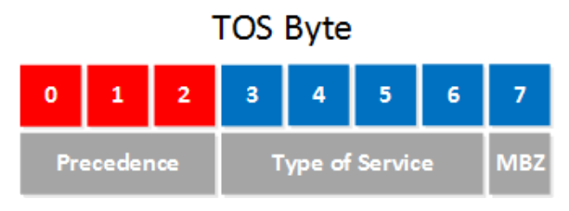
IP Precedence
Originally, only the precedence in the ToS byte was used:
The possible values for precedence:
(back in 1981)
(back in 1992)
IP Precedence | Decimal value | Bit pattern
Routine | 0 | 000
Priority | 1 | 001
Immediate | 2 | 010
Flash | 3 | 011
Flash Override | 4 | 100
Critical | 5 | 101
Internetwork Control | 6 | 110
Network Control | 7 | 111

Slide 11
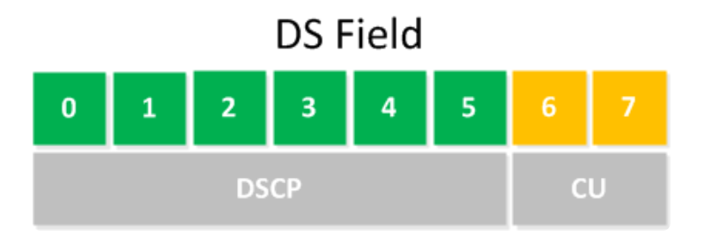
Differentiated Services
In 1998, the ToS filed gets a new name: DS field
The first 6 bits set a code point which affects the Per Hop Behavior
DSCP: Differentiated Services Code Point
DSCP PHB (Per Hop Behavior) options:
Default PHB
Class-Selector PHB
Assured Forwarding PHB
Expedited Forwarding PHB

Slide 12
Default PHB
The default PHB means that we have a packet that is marked with a DSCP value of 000000
This packet should be treated as “best effort”

Slide 13
Class-Selector PHB
Used for compatibility between precedence-capable devices and DSCP-capable devices (the only used bits are the first 3)
Class selector name | DSCP value | IP Precedence value | IP Precedence name
Default / CS0 | 000000 | 000 | Routine
CS1 | 001000 | 001 | Priority
CS2 | 010000 | 010 | Immediate
CS3 | 011000 | 011 | Flash
CS4 | 100000 | 100 | Flash Override
CS5 | 101000 | 101 | Critical
CS6 | 110000 | 110 | Internetwork Control
CS7 | 111000 | 111 | Network Control

Slide 14
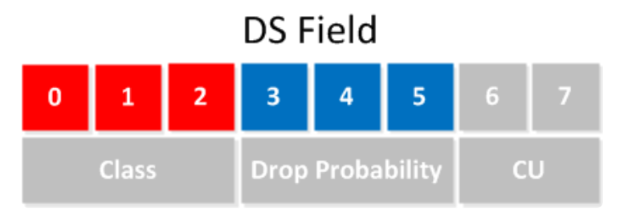
Assured Forwarding PHB
AF has two functions - queueing and congestion avoidance
Drop probability | Class 1 | Class 2 | Class 3 | Class 4
Low | 001010 AF11 | 010010 AF21 | 011010 AF31 | 100010 AF41
Medium | 001100 AF12 | 010100 AF22 | 011100 AF32 | 100100 AF42
High | 001110 AF13 | 010110 AF23 | 011110 AF33 | 100110 AF43

Slide 15
Expedited Forwarding PHB
The DSCP value is normally called “EF”
EF has two functions - queueing and policing
These packets experience minimum delay and packet loss
We need to set a rate limit for this priority queue, because it can “eat” the entire bandwidth
The real-time application packets (like VoIP) should be here
In binary it is 101110, the decimal value is 46

Slide 16
QoS tools
Classification and marking
Queuing
Shaping and policing
Congestion avoidance

Slide 17
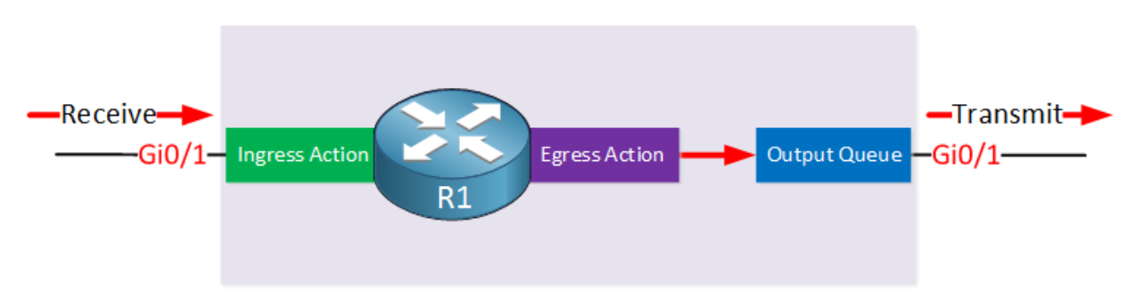
Queuing/Congestion management
In a router, after consulting with the routing table, the router will put a packet in an interface's queue (same applies for a switch, with frames)

Slide 18
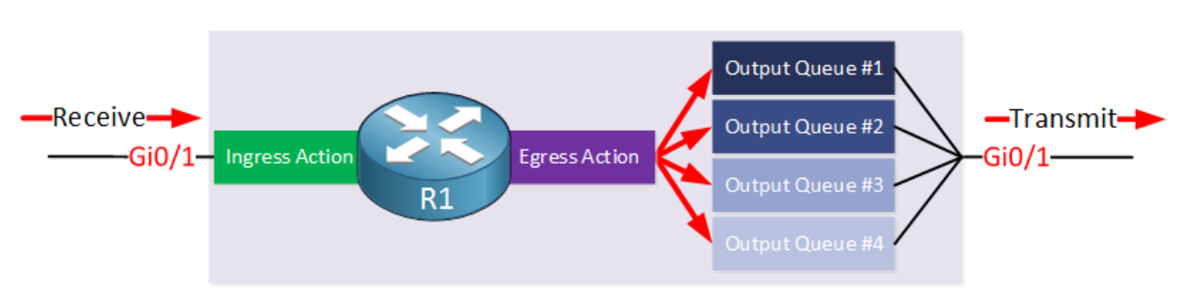
Queuing/Congestion management (2)
Most network devices has multiple output queues
Different scheduling options exist, for example:
Round robin
Priority Queuing
WFQ (Weighted Fair Queuing)
CBWFQ (Class Based Weighted Fair Queuing)

Slide 19
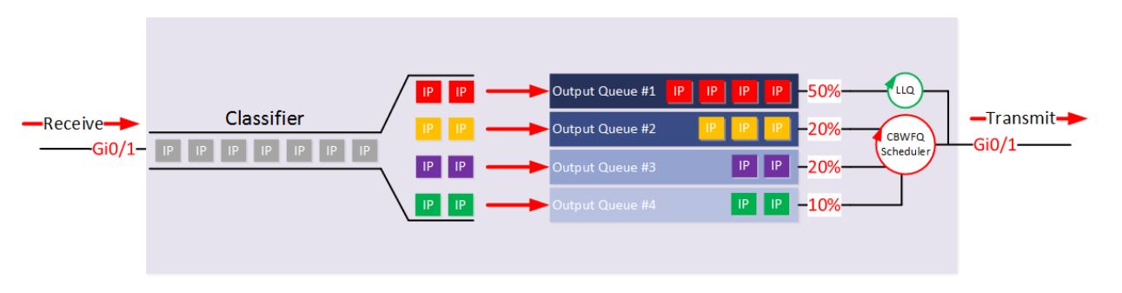
Queuing/Congestion management (3)
Voice traffic can be attached to LLQ (Low Latency Queue) in order to be sent immediately
It is important to limit the LLQ to ensure the other queues get served as well, otherwise que starvation will occur

Slide 20
QoS tools
Classification and marking
Queuing
Policing and shaping
Congestion avoidance

Slide 21
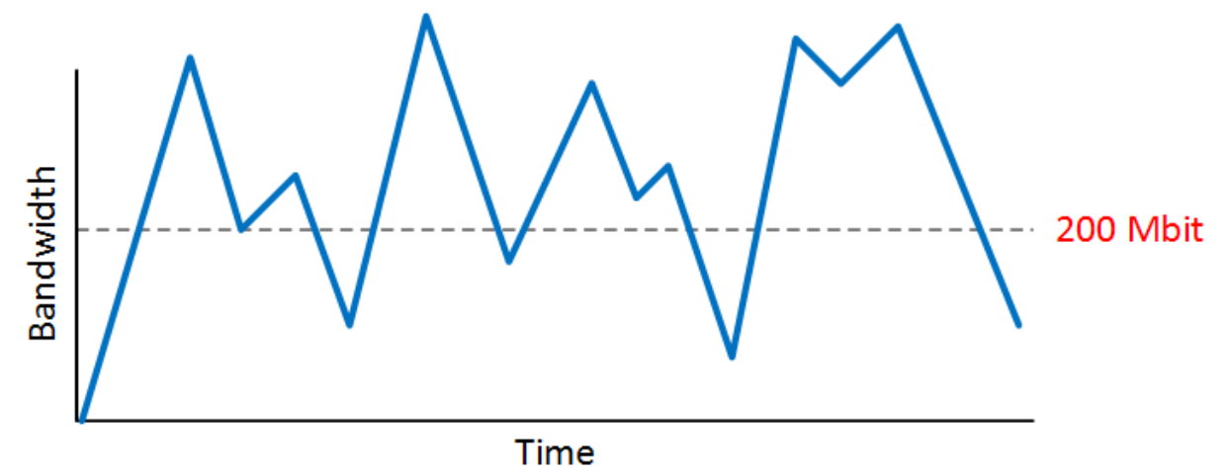
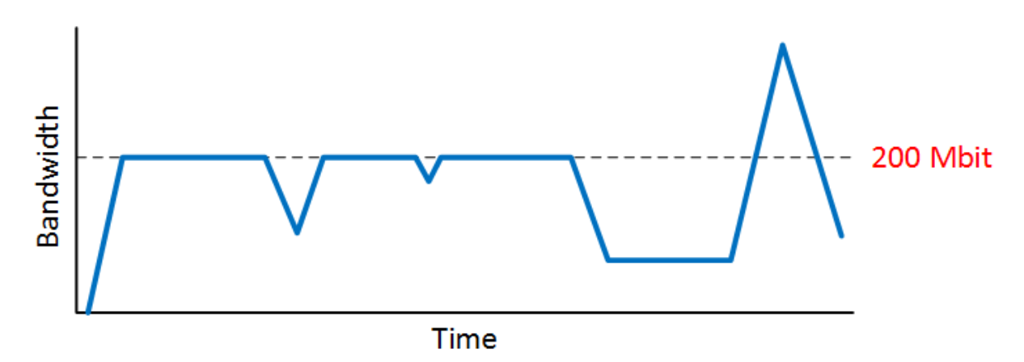
Policing
Policers discard traffic in order to meet the CIR (Committed Information Rate)
Without policing
With policing

Slide 22
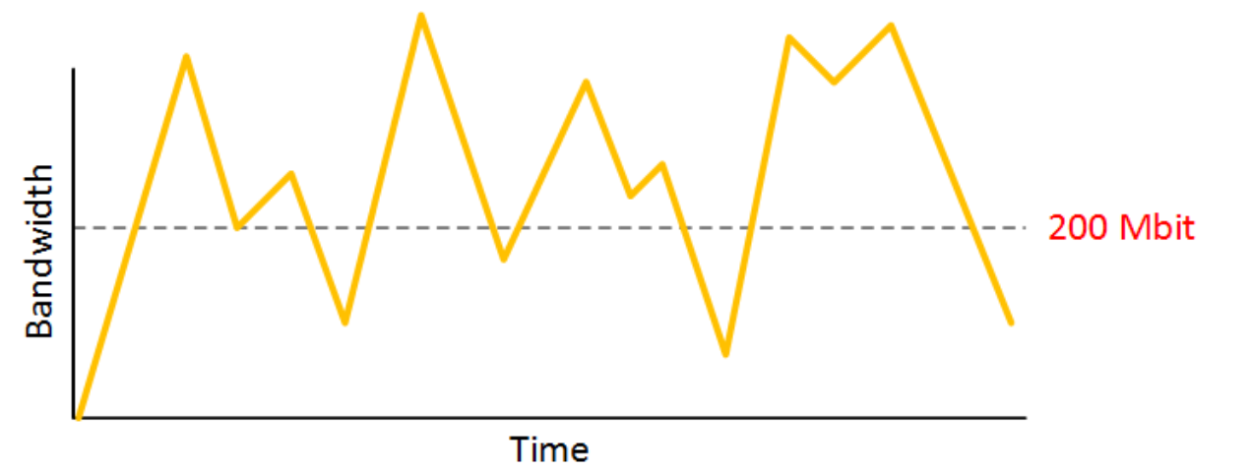
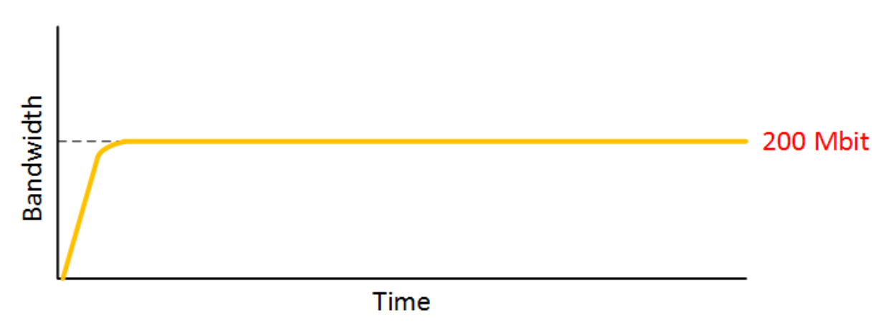
Shaping
Shapers hold packets in a queue, causing delay
This prevents the traffic from getting dropped at the other end
Before
After

Slide 23
QoS tools
Classification and marking
Queuing
Shaping and policing
Congestion avoidance

Slide 24
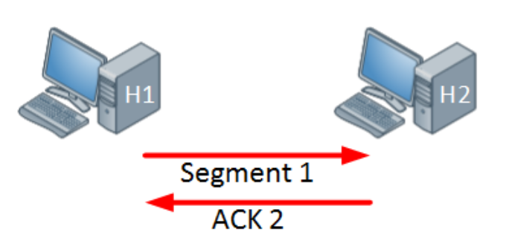
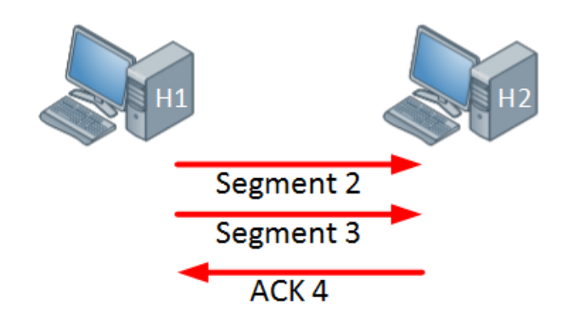
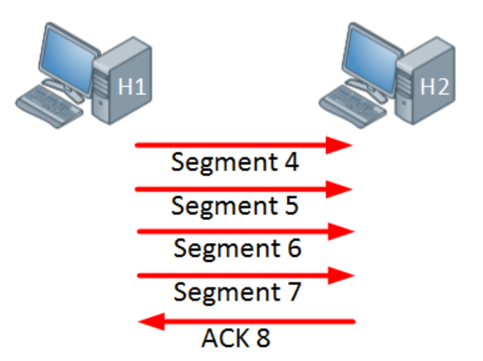
Congestion avoidance
Remember the TCP windowing?
Tail drop – when congestion occurs, all packets at the end are dropped
This causes TCP global synchronization
With congestion avoidance mechanisms, once the output queue is at certain level, it will drop TCP segments in order to reduce the window size
Example: WRED (Weighted Random Early Detection)

Slide 25
Port mirroring

Slide 26
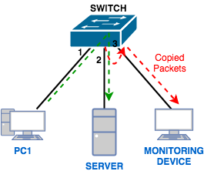
What is port mirroring?
Also called port monitor or SPAN (Switch Port Analyzer) in Cisco
Lets you copy all traffic from a source port or source VLAN to a destination interface

Slide 27
Why port mirroring?
SPAN can be useful for a number of reasons:
If you want to use Wireshark to capture a communication, you need to sniff
To redirect all traffic from a VLAN to an IDS/IPS
Redirect all VoIP calls from a VLAN so you can record the calls

Slide 28
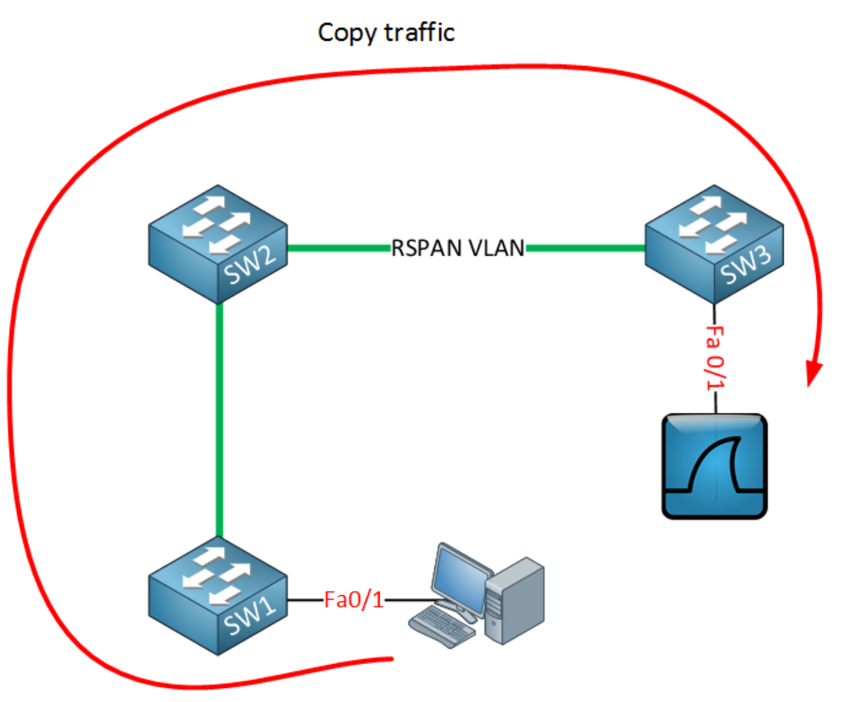
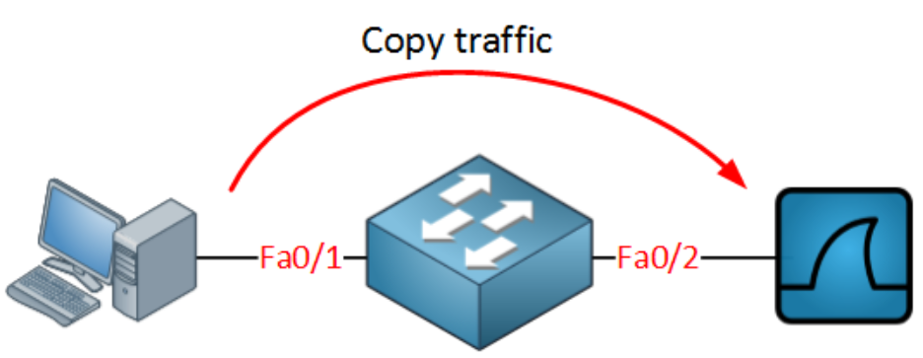
Types of SPAN
Local SPAN
RSPAN - Remote SPAN

Slide 29
SPAN specifics
Both SPAN and RSPAN have some specifics:
Source interface can be anything - L2/L3 port, access/trunk port, Etherchannel
If the source is trunk, all VLANs are copied (no filtering)
As source, you can use either ports or VLAN, but cannot mix them
Be careful not to overload the destination interface (it is easy!)
Some L2 frames, like CDP and STP BPDUs are not copied by default

Slide 30
Demonstration

Slide 31

Summary
Quality of service
Port mirroring
Demonstration
…
…
…

Slide 33












SoftUni Diamond Partners

Slide 34


Educational Partners

Slide 35
Trainings @ Software University (SoftUni)
Software University – High-Quality Education, Profession and Job for Software Developers
softuni.bg, about.softuni.bg
Software University Foundation
softuni.foundation
Software University @ Facebook
facebook.com/SoftwareUniversity
Software University Forums
forum.softuni.bg
Notes:
35

